Slide 1

Research on
Aviation industry
BBA 1st SEM (2022-23)
Submitted By-
Shankh Bansal
AU22C1013
Submitted To-
Dr. Ankur Rastogi

Slide 2

Objective
An opportunity to reach an audience with a distinct interest.
Creates awareness and develops relationship with new prospects.
Provides product demonstrations.
Gathers competitive intelligence.
Determines and stimulates needs of customers.

Slide 3
Aviation Industry
Air travel remain a large and growing industry.
It facilities economic growth, world trade, international investment and truism and Is therefore central to the globalization taking place in many other industries.
Travel for both business and leisure purpose grew strongly worldwide.
Some of the major players are:-
Air India
Jet airways
Kingfisher
Indigo
Spice jet

Slide 4
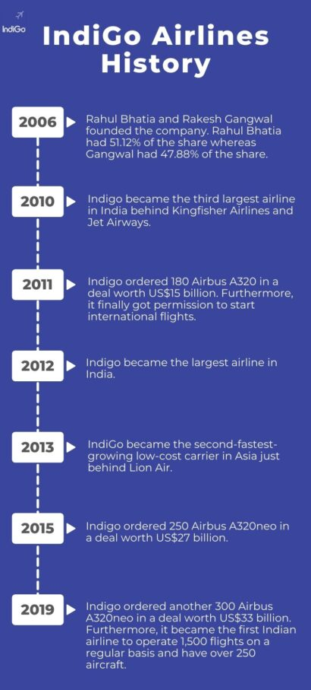


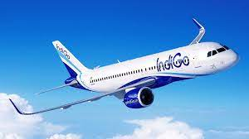
Indigo
Fly smarter with indigo charter

Slide 5
Internal Factors

Slide 6
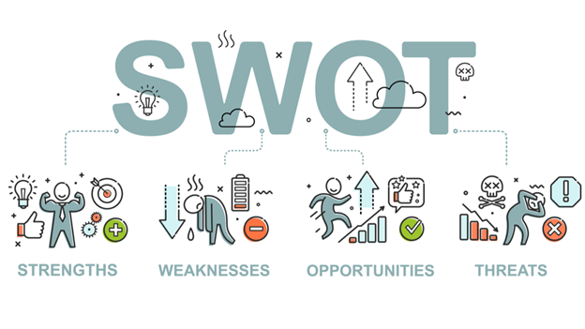

Slide 7

Strength
Increased potentiality to fly.
The safety record and the associated public acceptance of air as both a fast & safe way to travel.
Airline staff is highly trained and experienced, from piolets and flight attendance to mechanics and ground staff.
Airlines have the ability to segment the market to establish different levels of service and pricing decisions.
Ticket price.

Slide 8

Weakness
Aircraft is expensive and requires huge capital outlays.
Large workforces spread over large geographic area requires continual communication and monitoring.
Airlines have difficulty making quick schedule and aircraft changes due to staffing commitments.

Slide 9

Opportunities
Offers continual expansion
Opportunity for both leisure and business destinations.
Technology advances can result in cost saving, for more fuel efficient aircraft to more automated processes on the ground.
Technology can also result in increased revenue due to customer friendly service enhancement like in flight internet accesses and other value added products for which the customer will pay extra.

Slide 10

Threats
A global economic downturn negatively affects leisure, optional travel, as well as business travel.
The price of fuel is now the greatest cost for many airlines an upward spike can destabilize the business model.
A plague or terrorist attack anywhere in the world can negatively affect air travel.
Government intervention can result in new costly rules.
Selection of airport.

Slide 11



Strategic Situation
Global Challenges
Technological Progress
Extreme weather events might damage critical infrastructures and disrupt communications. The rapid urbanization and mobility of people will increase the risk from infectious disease. Due to this strategic relevance, large public transport hubs like railway station, airports and ports are considered a major potential target for terrorists.
Automation, robotics and AI are advancing quickly, transforming and working environment and changing the nature of work and the skills that employs need for doing their jobs. The future workforce will spend more time on activities of control, supervision, managing of people and communication.

Slide 12


Cyber security
Environment protection
Parallel to the or going digitalization within the air transport industry, there is growing awareness and concern about threats from cyber security. As system and planes become increasingly automated, the risk and potential impact of a cyber attack will continue to grow.
For the past decades, the airlines industry has been largely considered as a significant contributor to global carbon emission. As reported in the flightpath 2050 the environmental challenges and the use of renewable resources will be a key driver for the aviation sector.

Slide 13
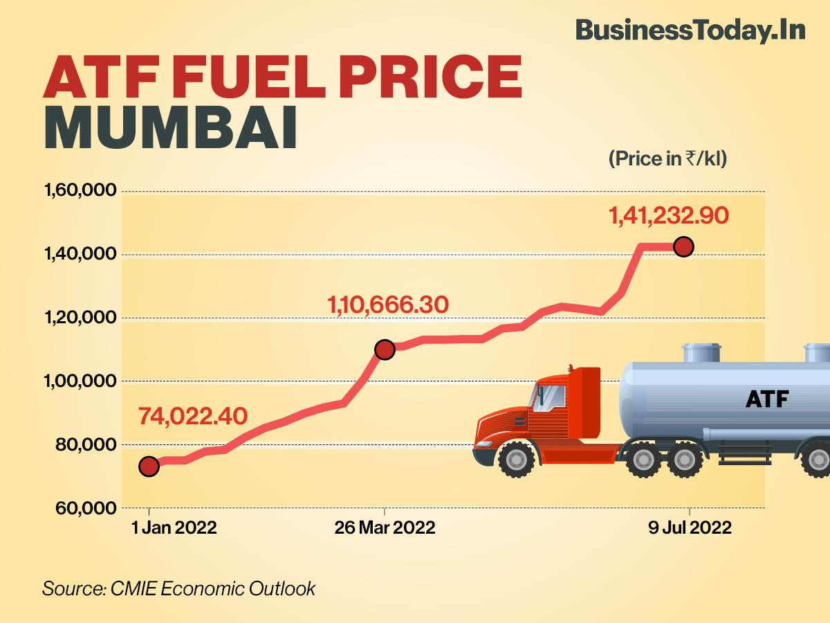
Inflation & exchange rate
The country’s aviation industry is one sector that has been impacted the most by a depreciating rupee and imported inflation ever since the beginning of the Russian military action in Ukraine in February.

Slide 14

Pay structure
The average Aviation sector pvt ltd monthly salary ranges from approximately ₹ 13,506 per month for Service Associate to ₹ 28,983 per month for Security Officer.
The average Aviation sector pvt ltd salary ranges from approximately ₹ 1,20,000 per year for New Graduate to ₹ 2,96,677 per year for Flight Attendant.

Slide 15
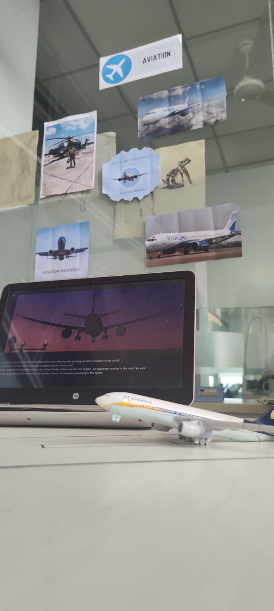
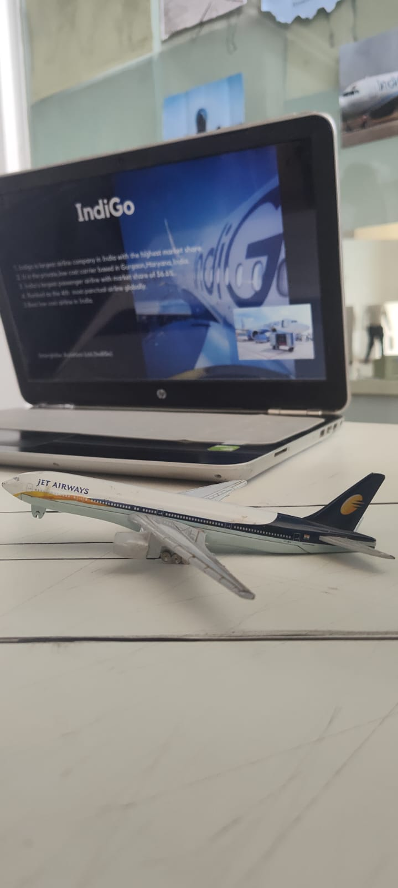
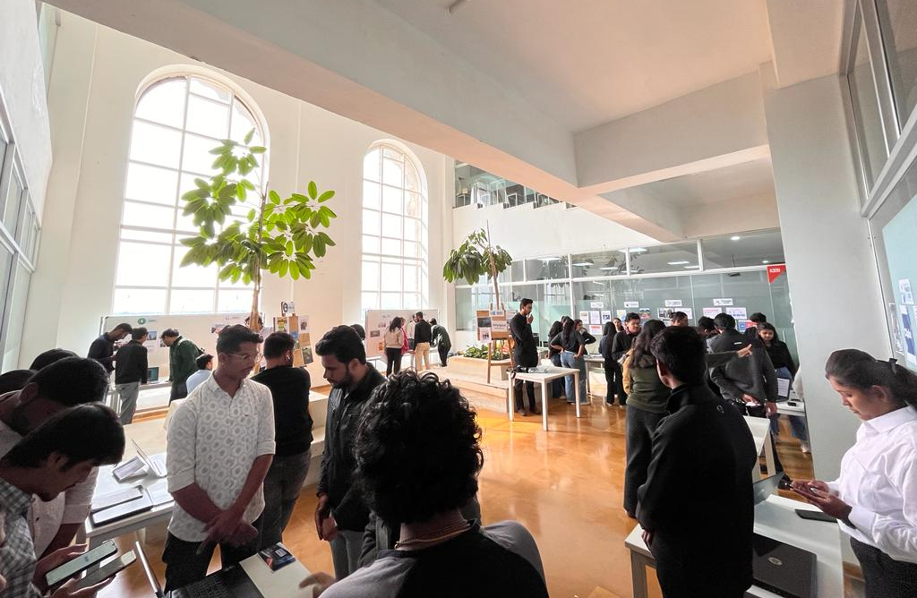
Glimpse

Slide 16
External Factors

Slide 17
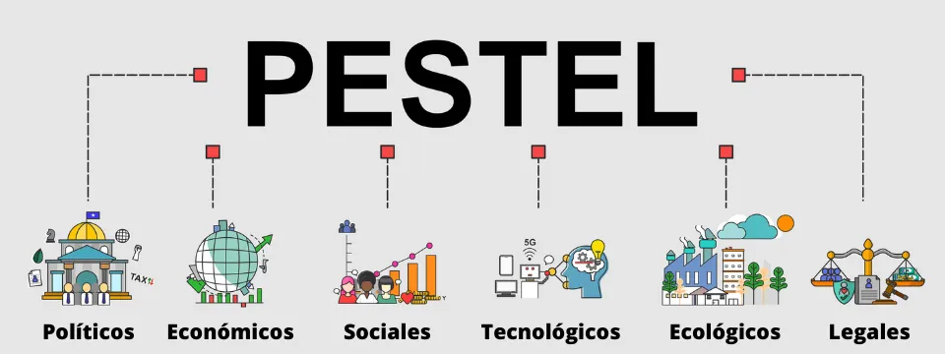

Slide 18

Political
The tax policy is different for different countries.
Security controls.
Restrictions on migration.
Government support for national crisis.

Slide 19

Economic
National growth rate.
Exchange rates.
Taxes.
Airport handling charges.
Fuel price hike.

Slide 20

Social
Rise in travel by elderly.
Student international study exchange.
Terrorism attacks in some part of world time to time have also left serious effects.
Wage inflation + union strikes

Slide 21

Technological
Fuel efficient engines.
Airframes
Security check technologies.
Teleconferencing for business.

Slide 22

Environmental
Noise pollution control.
Energy consumption control.
Land for growing airport.

Slide 23

Legal
Restriction on merges.
Preferential airport right for some carrier.
Fair deal environment.
Labour shortage

Slide 24
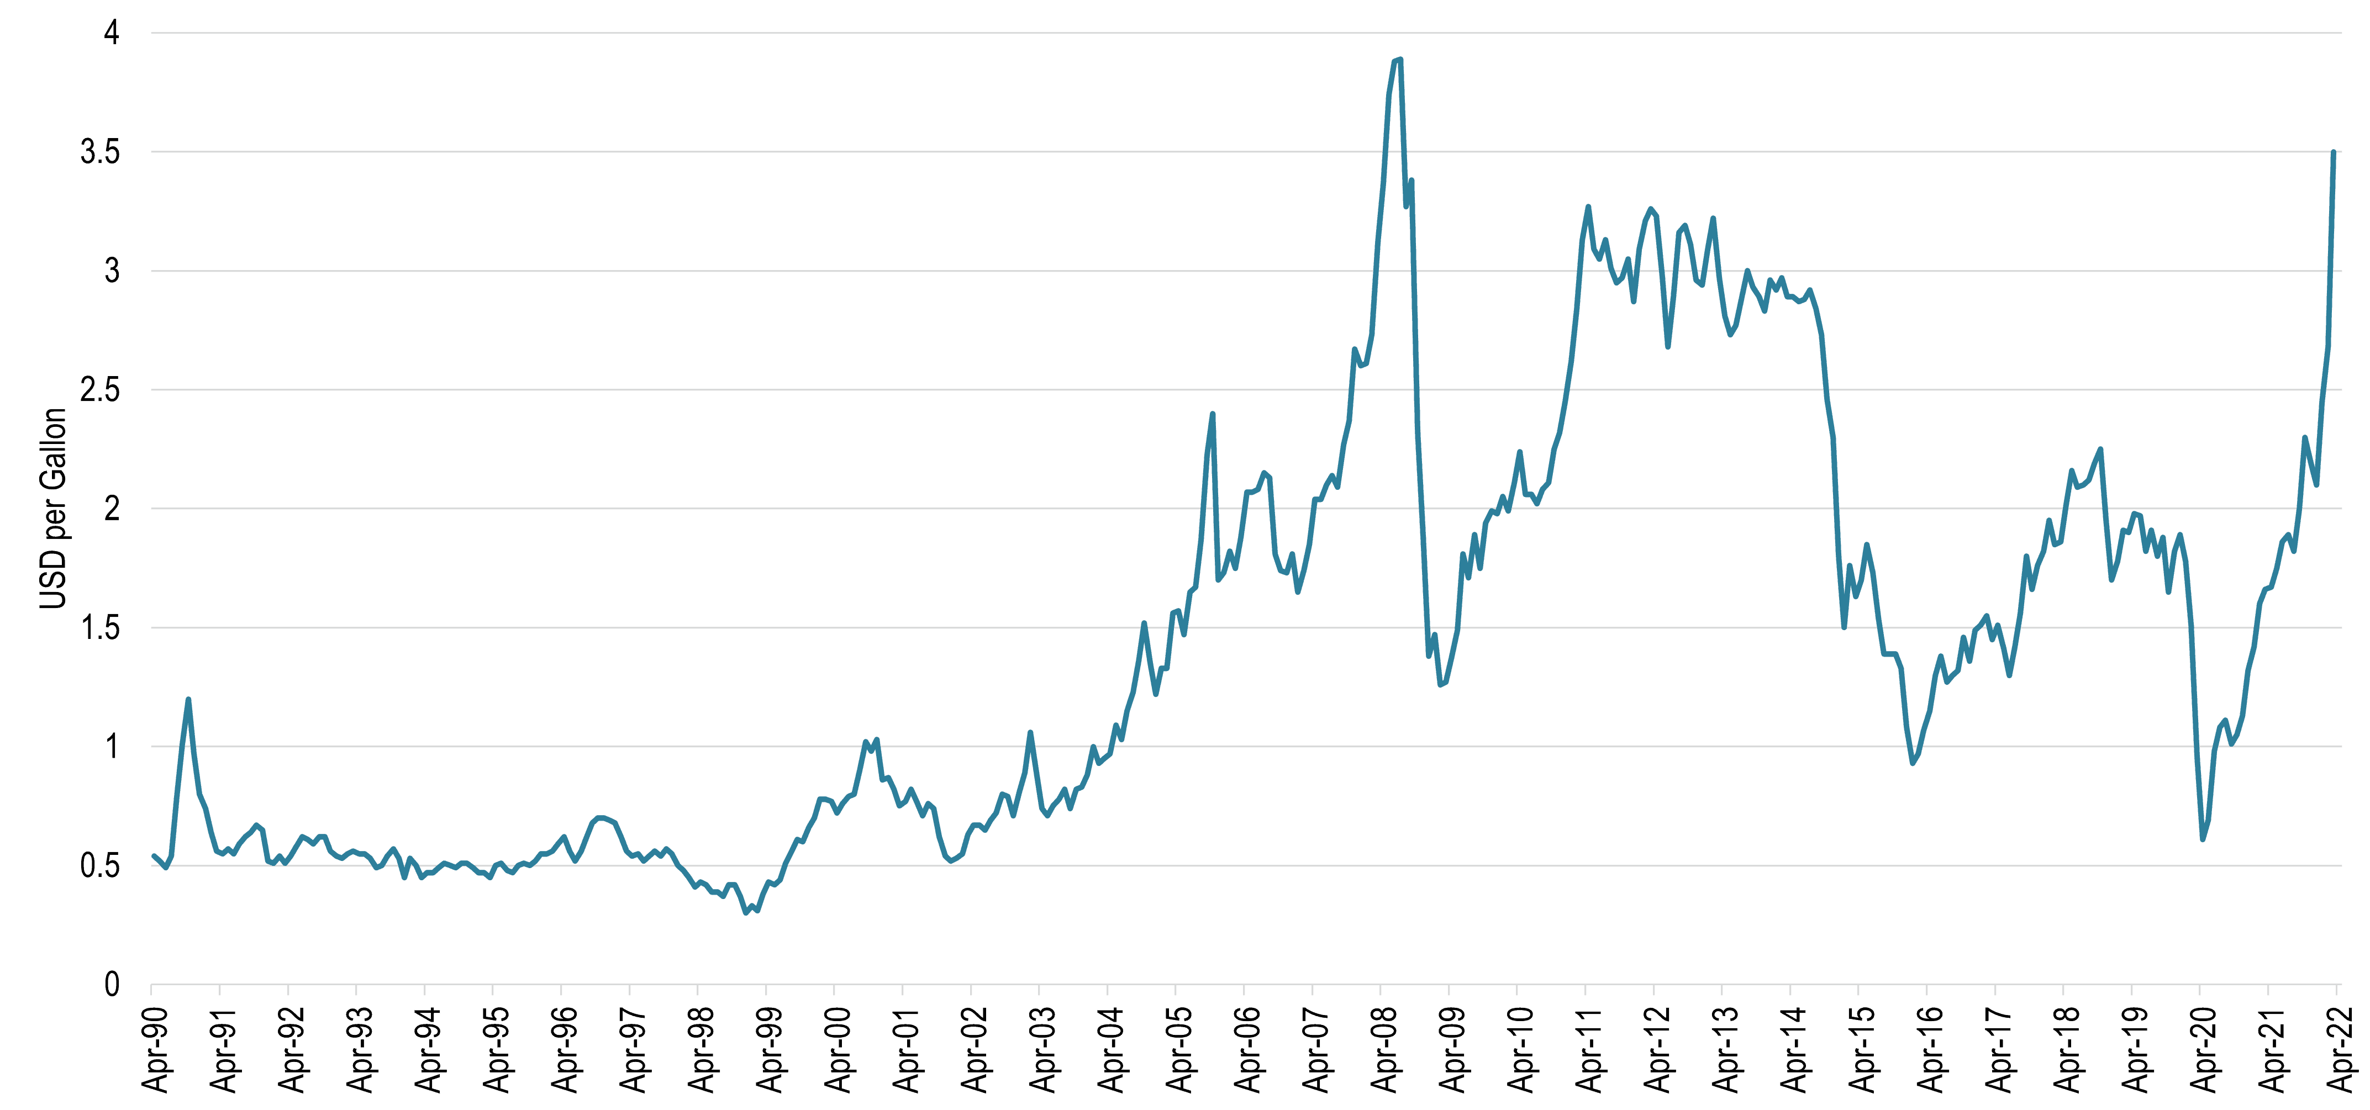
Price of oil:
this is the biggest factor, and tops as the number one airlines 'operating expense. The price of one barrel fluctuates around 93 dollars today.

Slide 25

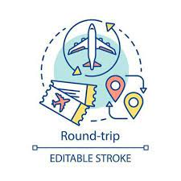
Flight distance:
it is common sense to say that the farthest you go, the more youpay. But this is not always the case as round-trip ticket do not cost as twice as one-way ticket.

Slide 26







Competitors

Slide 27

Learning Outcomes
Came to know about different factors that affect the industry.
Your Competition Can Be Your Collaborator.
Enhances critical & creative thinking.
Flexibility is Key.

